Slide 1
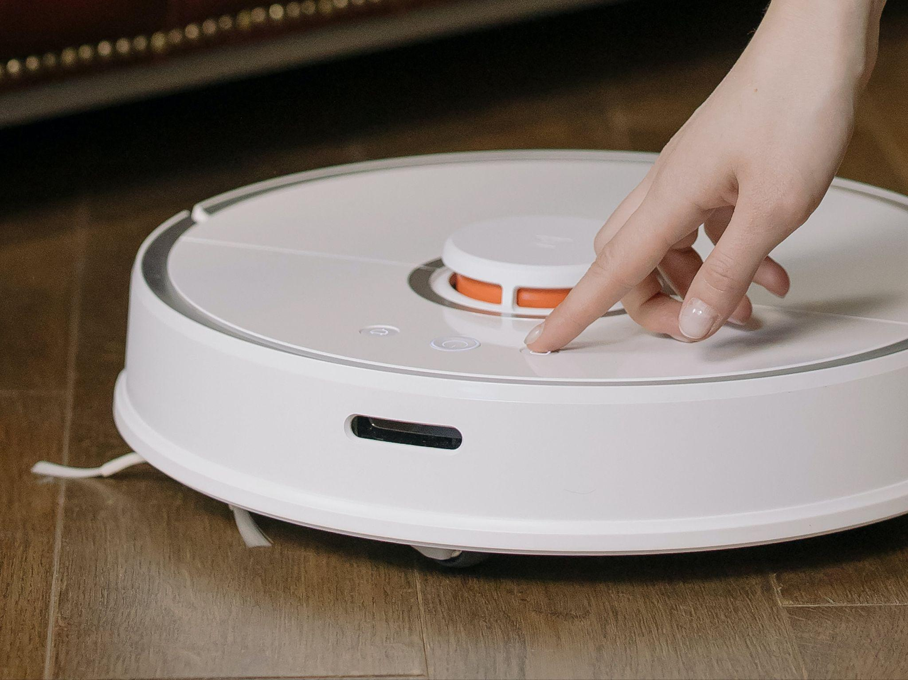
Robotic
Vacuum Cleaner
Milestone 2
Guide - Prof. Veeresh Deshpande
Alok Kumar 210070006
Arya Agarwal 210070012
Sumit Londhe 210070089
Yabaji Pratik Sanjay 210070094
Image from pixel.com
MON-02
Notes:
Good [afternoon], everyone! I hope you're all doing well. My name is [Your Name], and I'm excited to be here today to walk you through our project, the "Robotic Vacuum Cleaner," under the guidance of Professor Veeresh Deshpande. Along with me, are Arya Agarwal, Sumit Londhe, and Yabaji Pratik Sanjay. Today, we're going to explore the fascinating world of robotic vacuum cleaners. Let's dive in!

Slide 2
Outline
Summary of Progress on Milestone 1
Feedbacks and action
Progress on Milestone 2
Deviation from Milestone
Block Diagram and Schematic
Preliminary Testing
Work Ahead (Next Milestone)
Feedback

Slide 3
Summary of Milestone 1 and Feedback

Slide 4
Progress of Milestone 1
Research and Market Exploration : - Successfully researched on various research papers related to the technology on Robot Vacuum Cleaner. Also went through different available products in the current market.
Features Proposed:- Carefully proposed different features whose applications were of more useful and feasible for us to implement.
Component Selection:- Carefully selected the components which could work efficiently at the same time be feasible.
Physical Model:- Showcased the tentative model (in 3D), required components and calculations required.
Schematics:- Shown the initial schematics where all the components where connected with each other and the connections were shown.

Slide 5
Feedback Received and Actions Taken
Feedback | Action Taken
1.Concern over use of STM32. Recommended to test on both (Rpi and STM32) and then select. | Following the advice we tested our wifi interfacing and other controls on both, and found Raspberry Pi to be more convenient. Thus we chose Rpico.
2.Mass Balance problem | We have designed the model and placed the required components considering that COG of body remains little ahead of Centre.
3.Concern on App Development | We have actively work on it and ready with our basic app interface. Successfully implemented the wifi-communication over the App on Rpi pico.
4. Mass changing issue (mass changing wrt to time due to water tank). | We wish to first observe how it practically affects the motion of System at the time of dummy prototype testing. According to observations, we will try to modify the algorithm.

Slide 6
Progress so far
Milestone 2
Constructed Complete 3D Model on Fusion 360 with proper dimensions (fit with components).
Developed User Interface (UI) using Flutter.
Tested Wifi-Integration from App to Raspberry Pi Pico
Developing Algorithms for Path Planning and Object Avoidance.

Slide 7
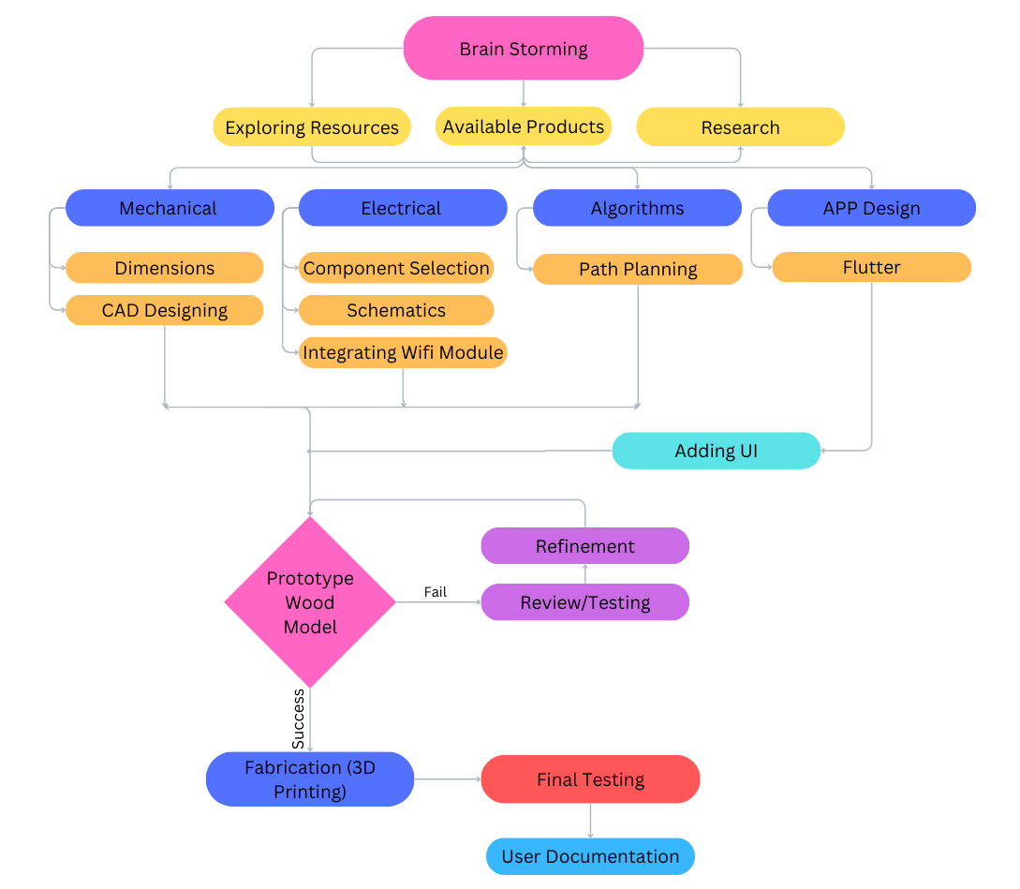
FlowChart
We are here
Notes:
Now I'll talk about the methodology we'll be using for our project
This flow chart illustrates the workflow of our project
We begin with collaborative brainstorming, which involves exploring available resources and products, as well as conducting research and literature surveys on the designs and functionalities of models available in the market
"Next, we divide our process into subtasks based on mechanical, electrical, algorithm, and app development.
In our mechanical phase, we'll define dimensions and weight based on specifications and design a CAD model for visualization. Electrical tasks involve selecting components, designing circuit schematics, and integrating a WiFi module. Algorithm work focuses on path planning and optimization. As for app development, our initial task is to learn Flutter and become familiar with it to create our app. Then we will make a prototype model from wood and Assembleing the mechanical and electronic components into a final prototype and conductiterative testing and refinement .
After a satisfactory number of tests we proceed to fabrication. Then next final testing and then documentation
// Also explain the chart in little bit detail.

Slide 8
3D Model
Important Dimension:
Diameter of Body - 300mm
Height of Body - 70mm
Dimension of Dustbin - 150mm x 50mm x 60mm (450ml)
Dimension of Water Tank:- 120mm x 50mm x 50mm (300ml)
Degrees btw Sensors:- 45deg
Expected Weight (at Full Water and Dust Tank):- Around 5Kg

Slide 9
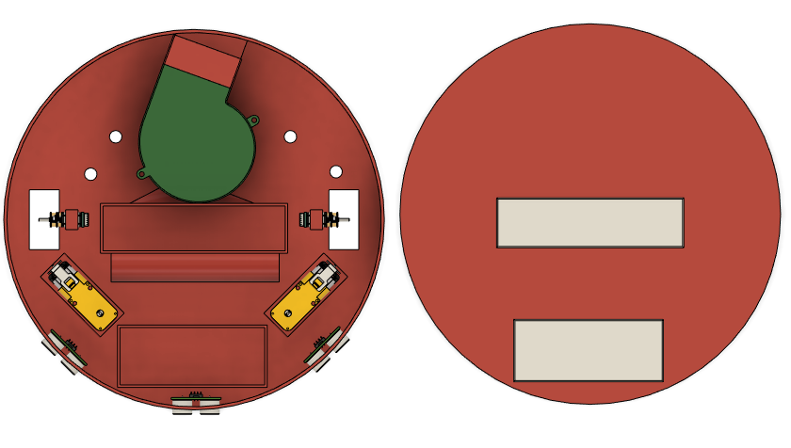
3D Model
Blower
Main Body
Top Lid
Holes for Mopping
Dustbin
Sensor
Front
Water Tank

Slide 10
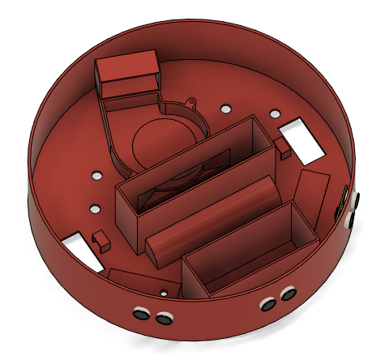
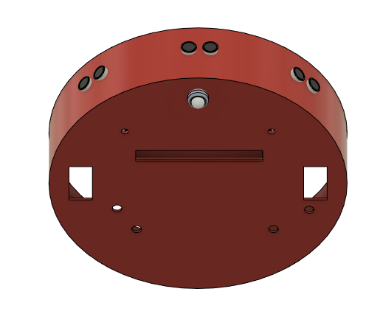

Slide 11
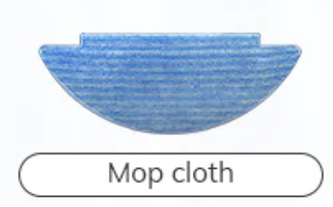
Mopping Mechanism
As part of the features we are implementing, we have currently devised a basic technology for mopping feature.
It consists of mopping cloth (ideally made of micro-fibre) attached at the bottom back portion of the vacuum cleaner through velcro tape.
We will make small holes (preferably 4 holes on the base below which the cloth is attached. This will allow the water to flow slowly through the ports and then wet the cloth.
We connect the 4 holes to the water tank at front through thin pipes.
For now, it is completely manual feature which the user has to control.
We will still research over it to make it more automates and electronically controlled.
*Inspired from Mi Vacuum Cleaner Mopping Mechanism

Slide 12
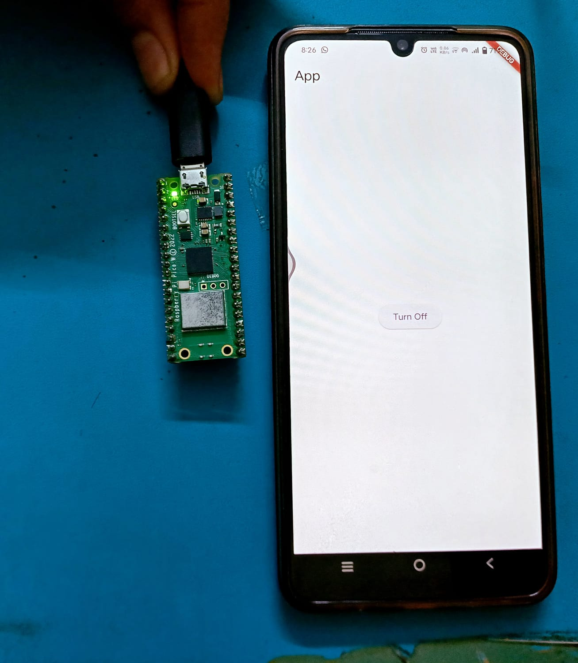
Wifi - Integration and UI
Successfully Tested the Wifi Interface with Rpi Pico W.
Developed a basic demo App with Flutter to control a LED through phone over wifi , Thus Successfully establishing Wifi Communication over App with Raspberry Pi Pico.
More Works to be done to enhance the User Interface to implement more features and controls.
Working on improvement of some small bugs to be sorted.

Slide 13

Path Planning

Slide 14
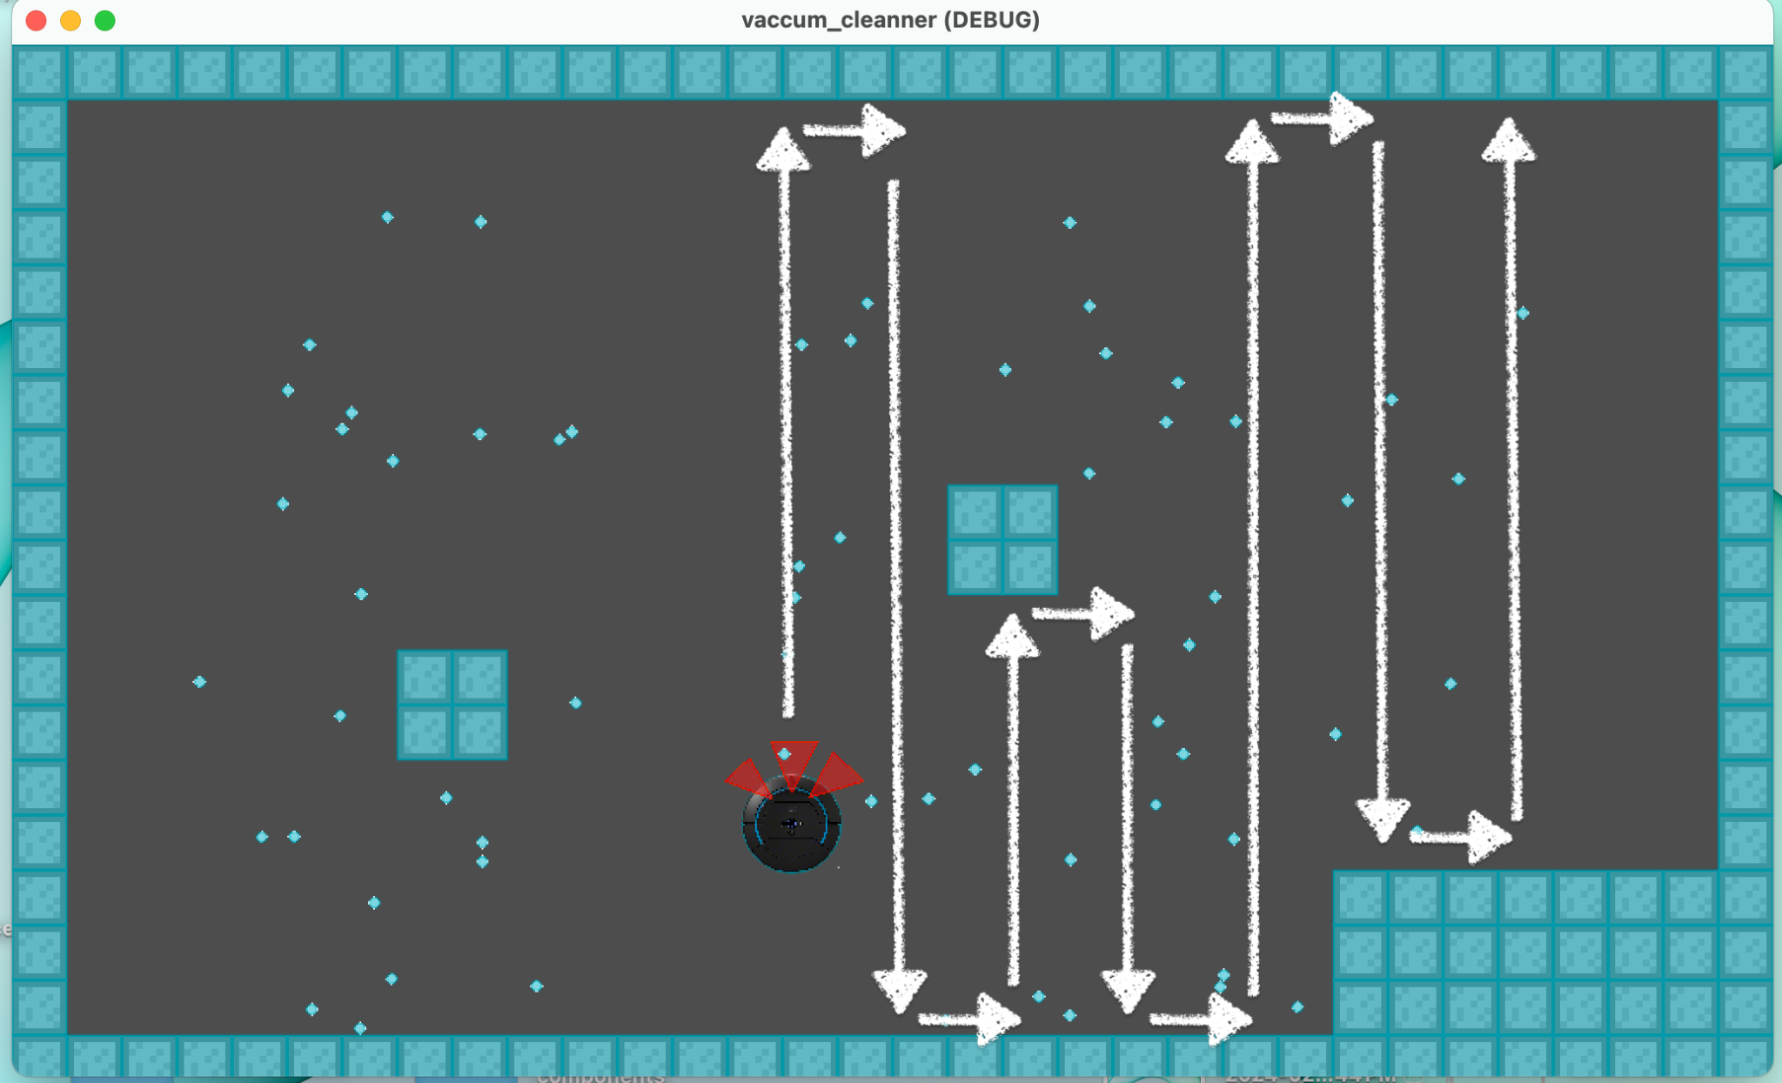
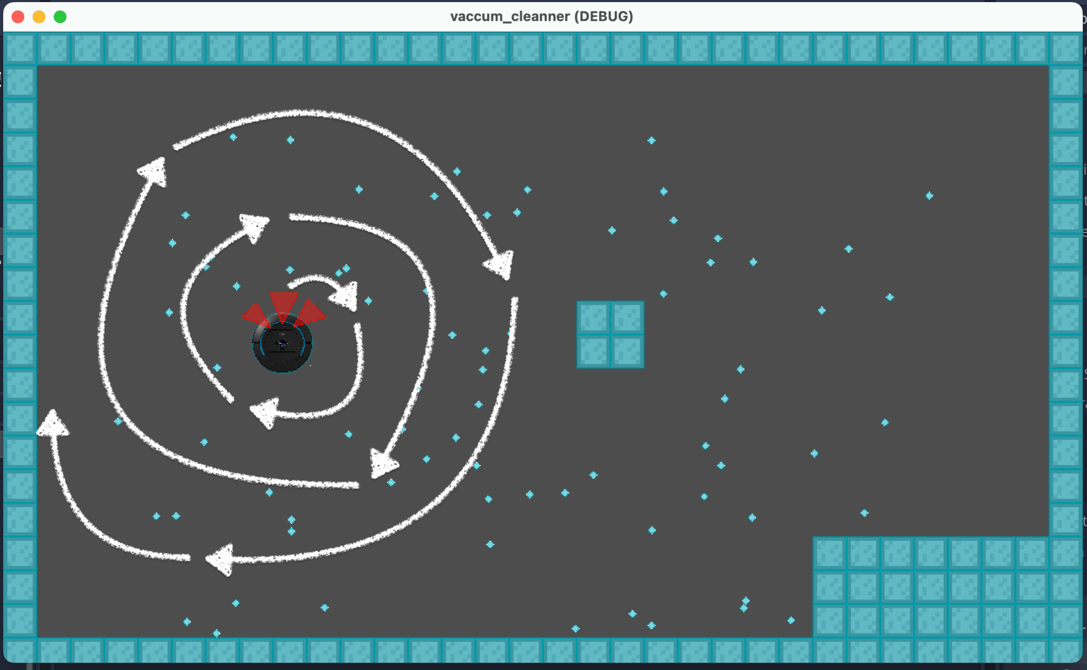
S-Shape Path
Summary: S-shaped movements to navigate spaces efficiently.
Advantage: Predictable movement, suitable for narrow spaces.
Disadvantage: Struggles with complex environments, potential deadlocks.
Circular Path
Summary: Circular movements cover areas systematically.
Advantage: Smooth motion, well-suited for wide spaces.
Disadvantage: Limited maneuverability in narrow areas, lacks adaptability.

Slide 15
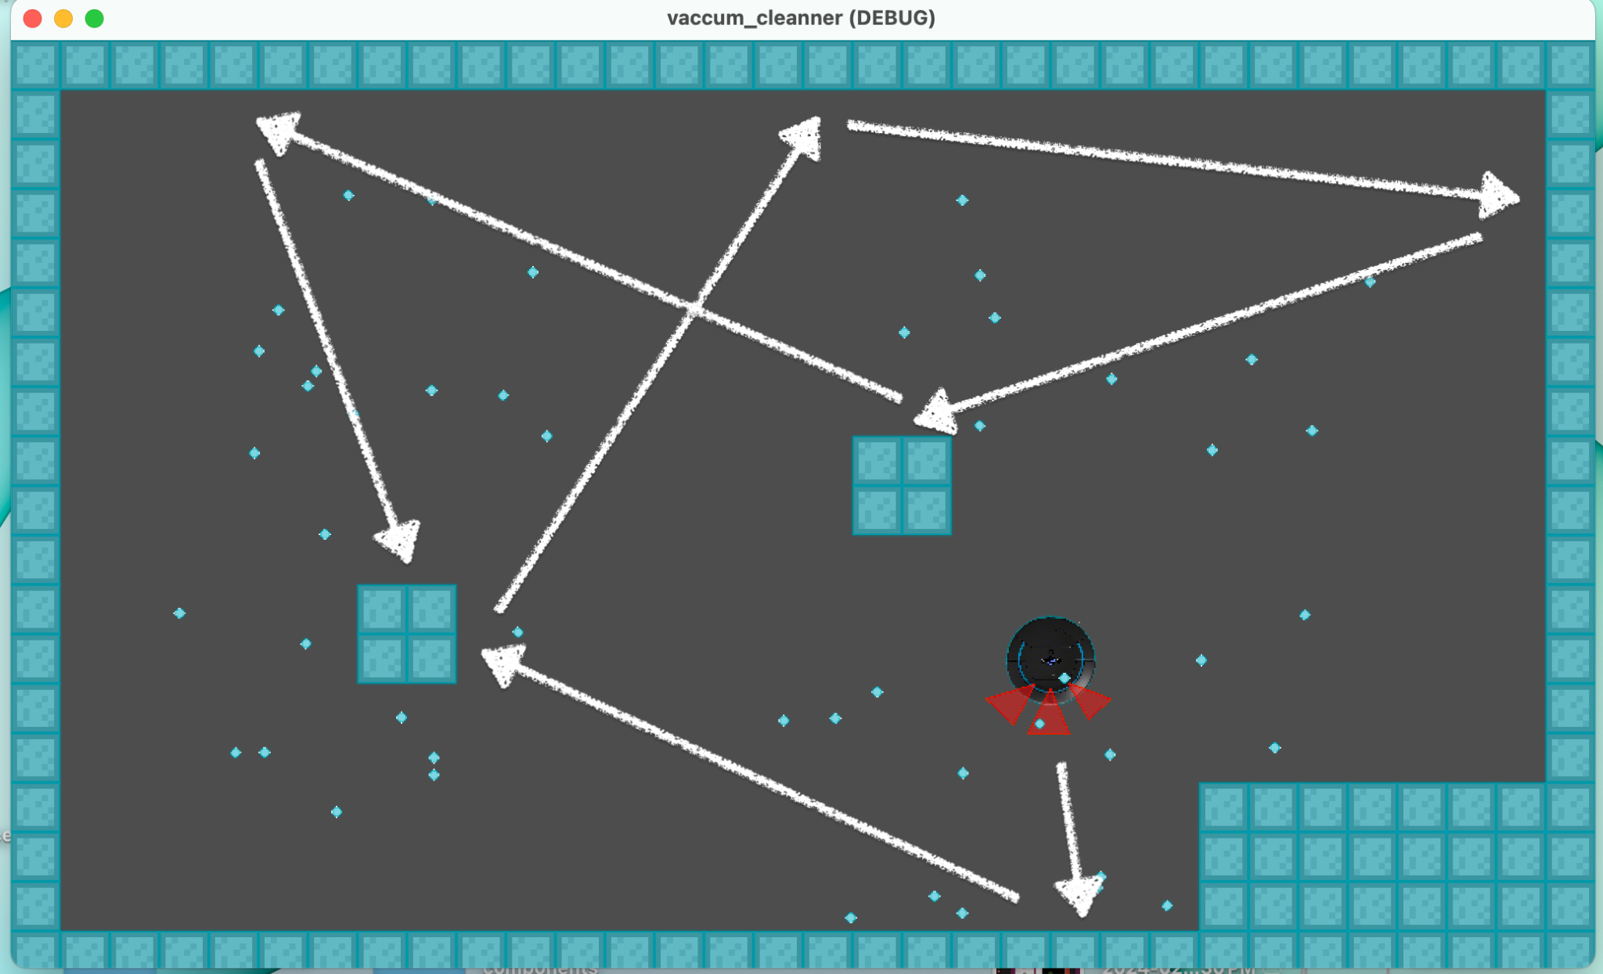
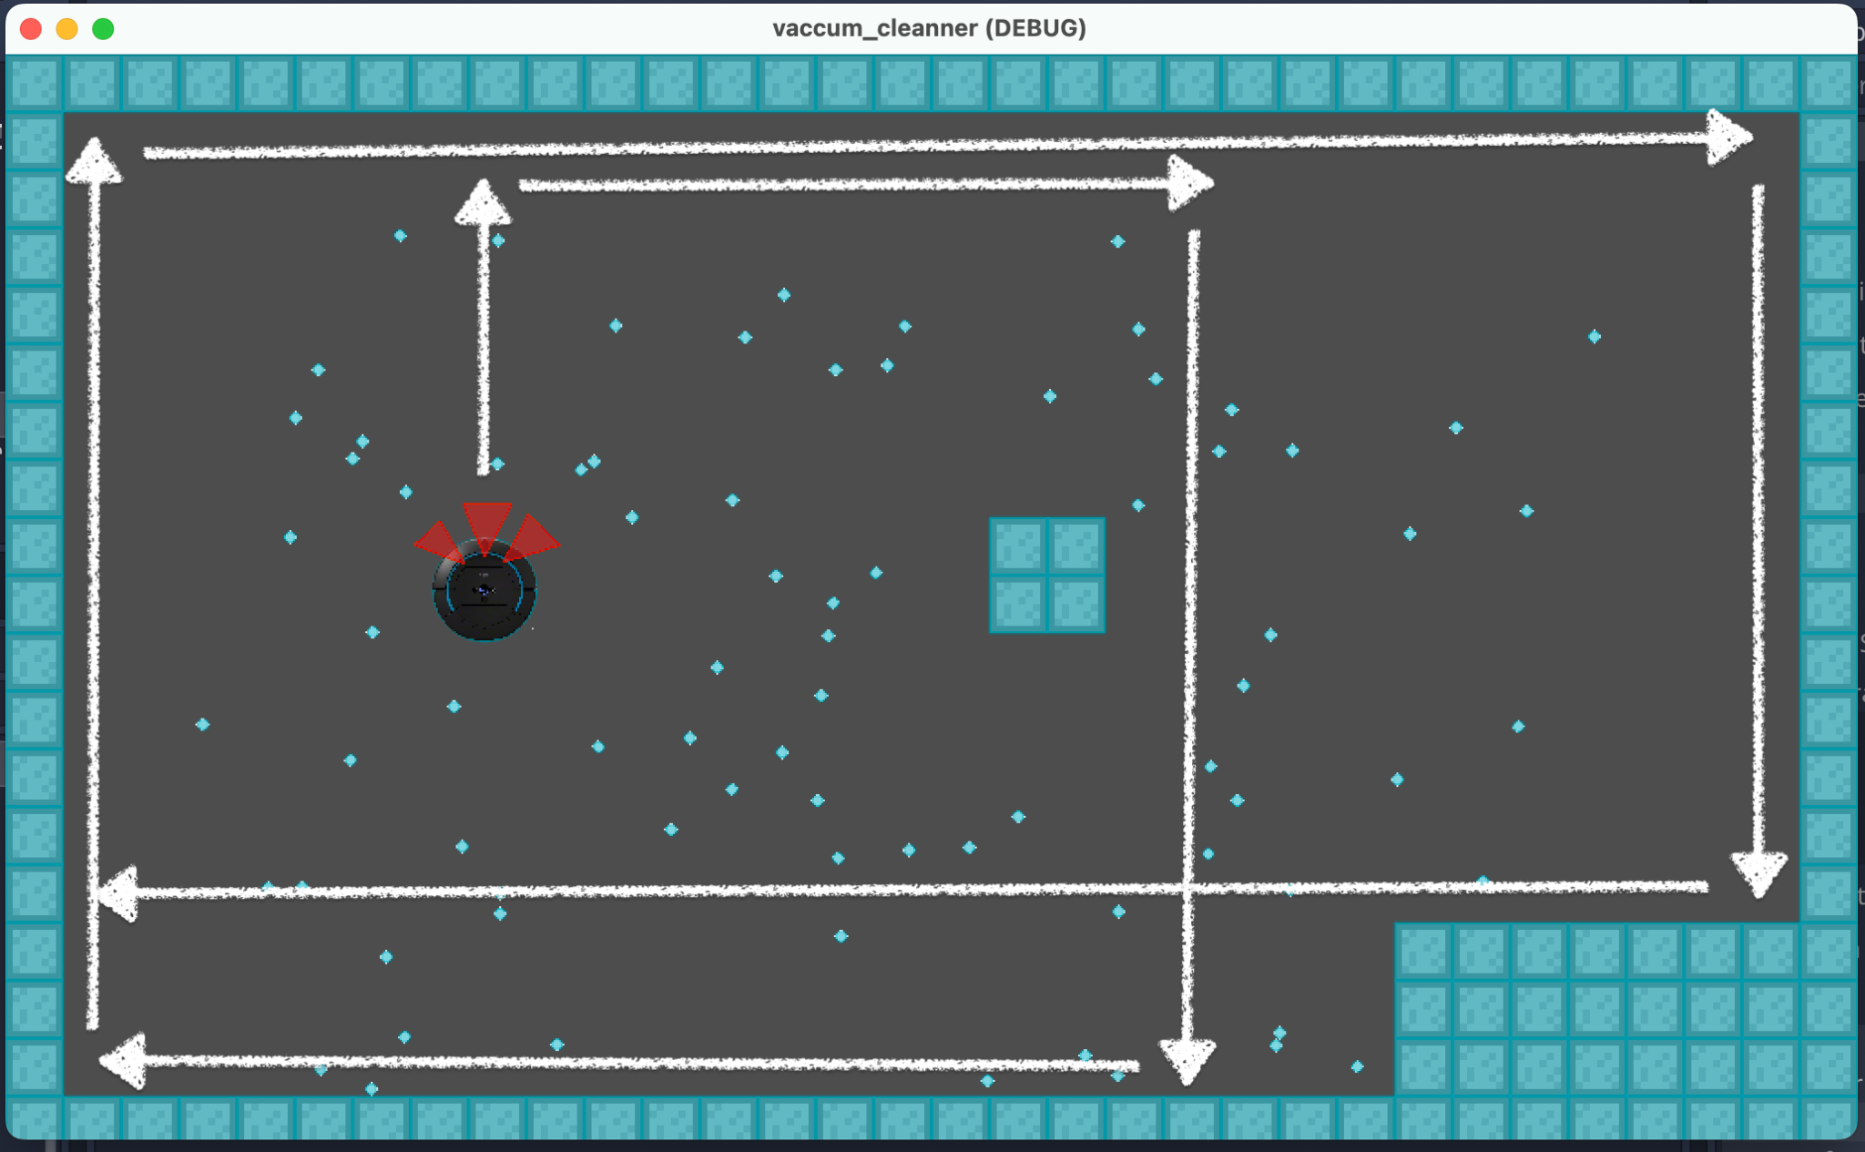
Random Path
Summary: Unpredictable movements for exploration.
Advantage: Adaptable, facilitates exploration.
Disadvantage: Inefficient coverage, potential for backtracking.
Random-90
Summary: Turns right or left after random interval of time
Advantage: Efficient coverage, clear direction for corners.
Disadvantage: Complex implementation, sensitivity to wall structures.
Notes:
//Explain point wise
Research Breakdown: Breaking down the project into manageable tasks and subtasks, we considered timelines, resource availability, and dependencies. This approach facilitated effective organization through tools like Gantt charts.
Segmented Development: To maximize efficiency, we segmented the process into mechanical, electrical, and software subsystems, assigning tasks based on the team's skills and interests.

Slide 16
Deviation From Gantt Chart
Notes:
Now that we've dissected the challenges, let's unravel our ingenious solution and the intricate technical specifications that make it a game-changer. Imagine a vacuum cleaner not confined to mere suction but equipped with features that elevate it to a sophisticated home maintenance assistant.

Slide 17
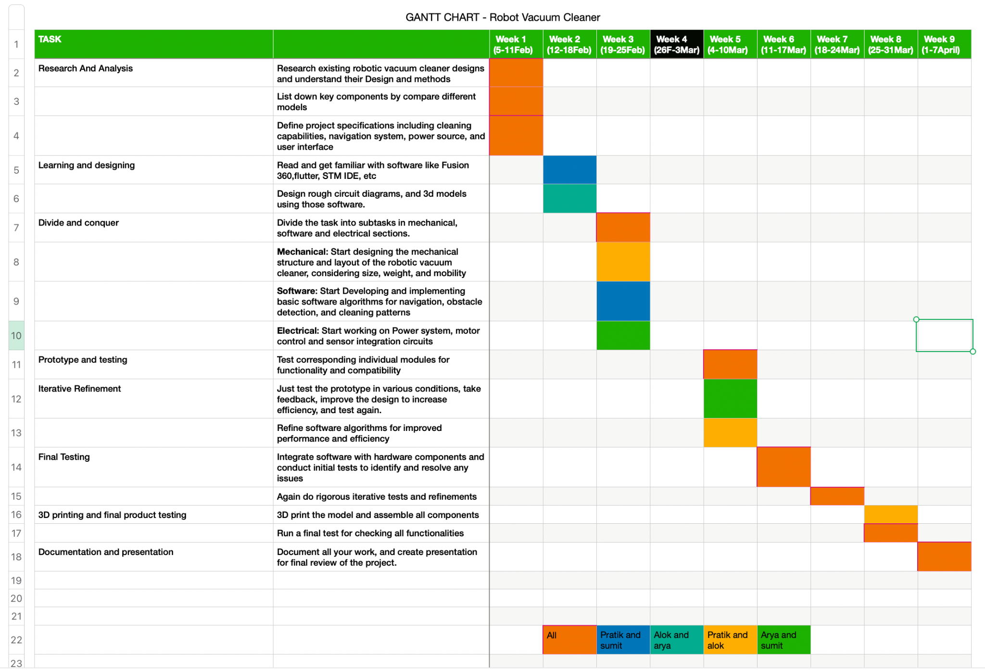
Previous Gantt Chart
Notes:
Here's our journey, step by step:
1. **Research and Learning:** We started by studying existing robotic vacuum cleaners to understand how they work.
2. **Breaking Down the Project:** We then divided the project into smaller tasks, thinking about timelines, resources, and what we needed.
3. **Dividing into Teams:** We split the work into three parts - one for the physical parts, one for the electrical stuff, and one for the software. This way, everyone worked on what they were good at.
4. **Choosing the Right Parts:** We picked the best-quality parts that weren't too expensive, making sure they were available and worked well together.
5. **Making a Prototype:** Using special computer programs, we made a rough design of our vacuum cleaner to see how everything fits together.
6. **Putting it Together and Testing:** We built the actual vacuum cleaner with all its parts and tested it a lot to see if it works well.
7. **Making it Better:** Based on our tests, we made changes to the design to make it work even better. This is called optimization.
8. **Writing Everything Down and Getting Ready to Show:** We wrote down every single thing we did - how we designed it, the tests we did, and everything. We also got ready to show it to other people in presentations and demos.
Our journey is more than just a bunch of tasks. It shows how we worked together in a planned way to make our project a success.

Slide 18
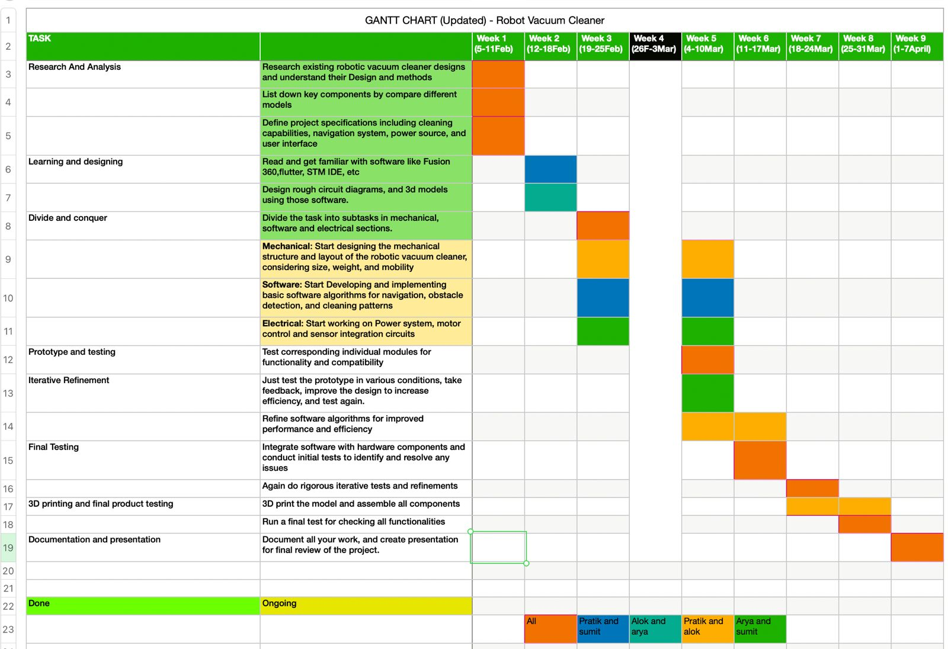
Updated Gantt Chart

Slide 19
Reasons for Deviations from Gantt Chart
Mechanical and Structure Design | We could not start working on it as we could not receive the materials in week 4. We will start building test models this week.
Software (Developing Algorithm) | The work is ongoing, we have implemented the obstacle avoidance algorithm on simulation. Still working on more better algorithms.
Electrical (Power Management and Circuit Integration) | Implemented the schematics on software. Could not implement it hands-on as components were not available.

Slide 20
Block Diagram

Slide 21
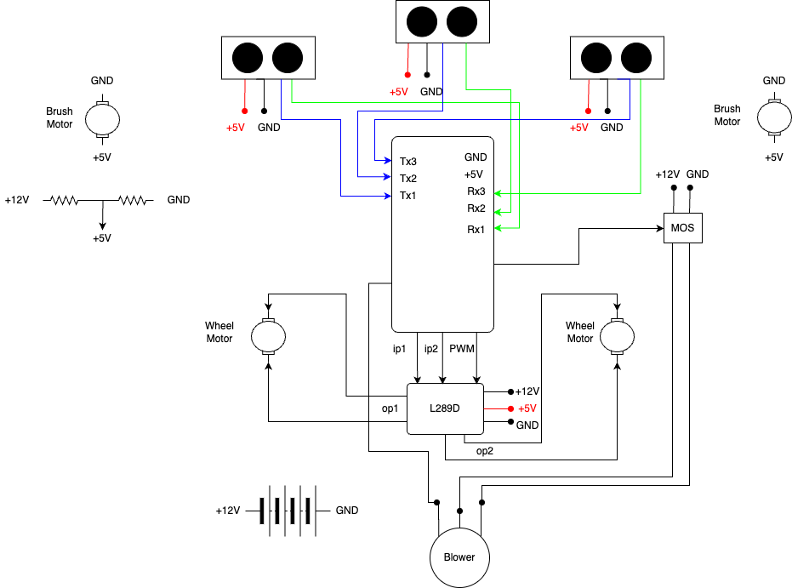
Circuit
Diagram

Slide 22
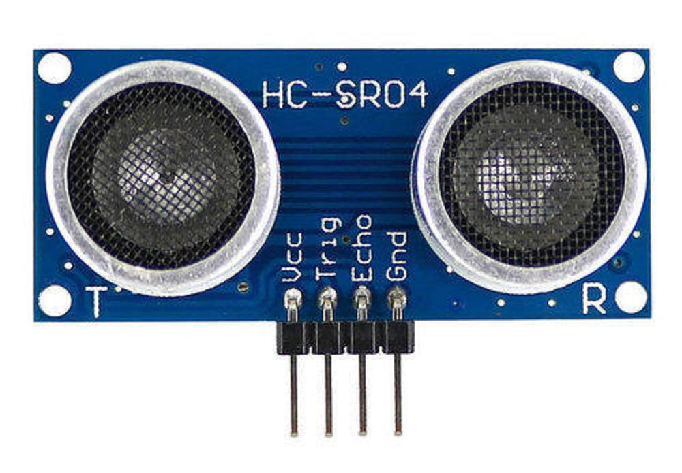
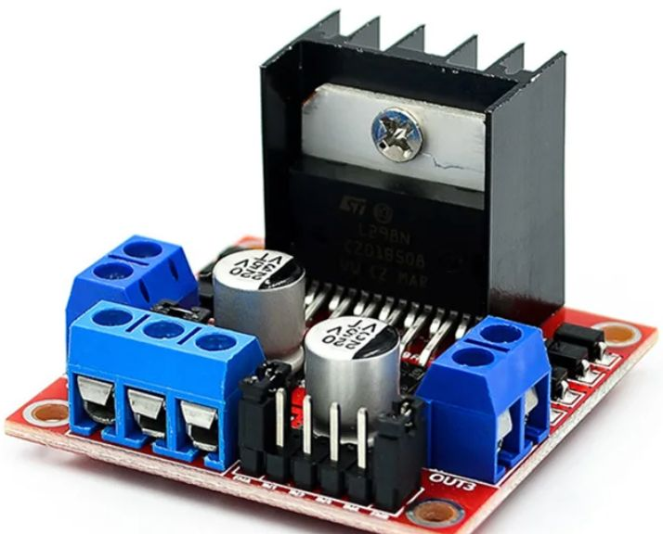
BLOCK DESCRIPTION
Ultrasonic Sensor
The US sensor has 4 terminals namely GND, VCC, Trig and Echo.
The Trig pin is used to trigger the sensor, and the Echo pin is used to receive the echo signal.
Connections:
VCC terminal connected to 3.3V pin of Rpi.
GND terminal connected to GND pin of RPi.
Trig and Echo connected to GPIO pins (here Rx and Tx) on Rpi.
L298 Motor Driver
Motor Driver is used to provide controlled speed to driving motors. It also supplies power to both the motor. It is essential to use for voltage and current regulation.
Connections:-
Two input terminals (IN1, IN2) connected to GPIO pins on Rpi.
Two output terminals (OP1, OP2) connected to motors.
+12 and GND terminal connected to batteries

Slide 23
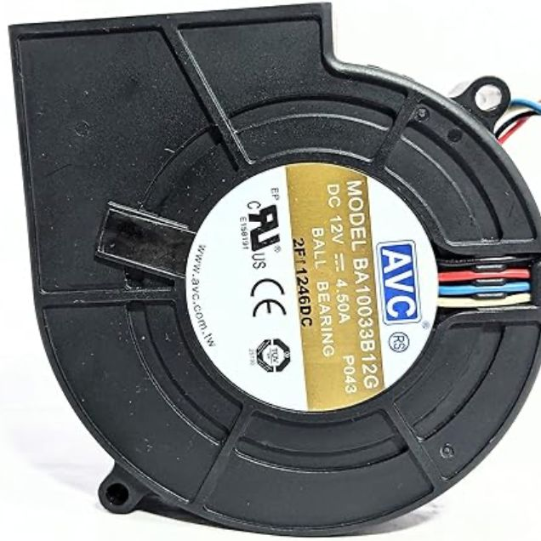
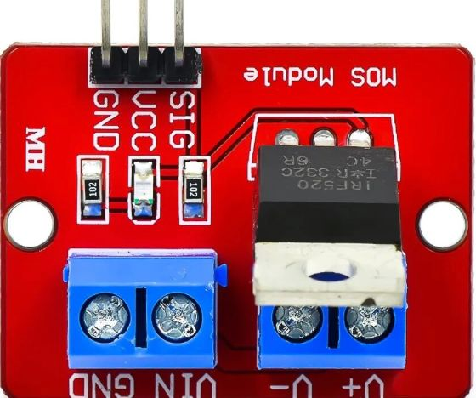
BLOCK DESCRIPTION
Blower
Main component of the Model. It has 4 terminals in total. These are +12V (red), GND (black), PWM(blue) and multipurpose (white).
Connections:
+12V terminal connected to OP pin MOS module.
GND terminal connected to GND pin of MOS Module.
PWM (control) terminal connected to GPIO pin of Rpi.
MOS Module
MOS Module is important for regulating different voltages and current sent to different components at their rating.
Connections:-
Power (+12V and GND) connected directly to battery.
OP (5V) pin connected to Supply pin of Rpi.
OP (12V) pin connected to Blower and L298N.

Slide 24
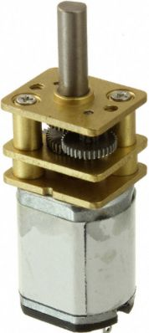
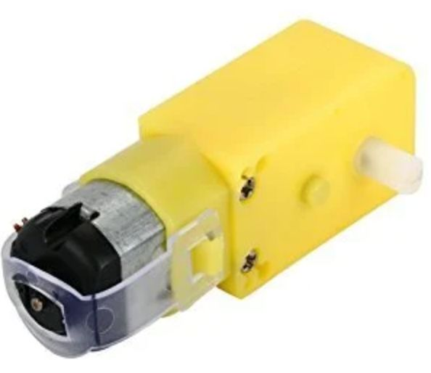
BLOCK DESCRIPTION
Driving Motor
Two DC (12V) geared motor used attached to the wheels. Has simple two terminals, supply and GND.
Connections:
12V supply pin connected to Op of L298N.
GND connected to GND pin of L298N
Brush Motor
Couple of DC Motors (300rpm) used for implementing Brushing Feature. Has 2 terminals.
Connections:-
Power (+12V and GND) connected directly to battery.
OP (5V) pin connected to Supply pin of Rpi.
OP (12V) pin connected to Blower and L298N.

Slide 25
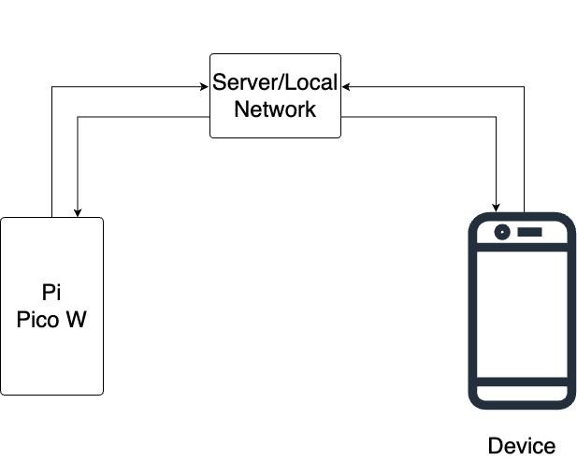
Communication Protocol
POST/GET
HTTP request

Slide 26
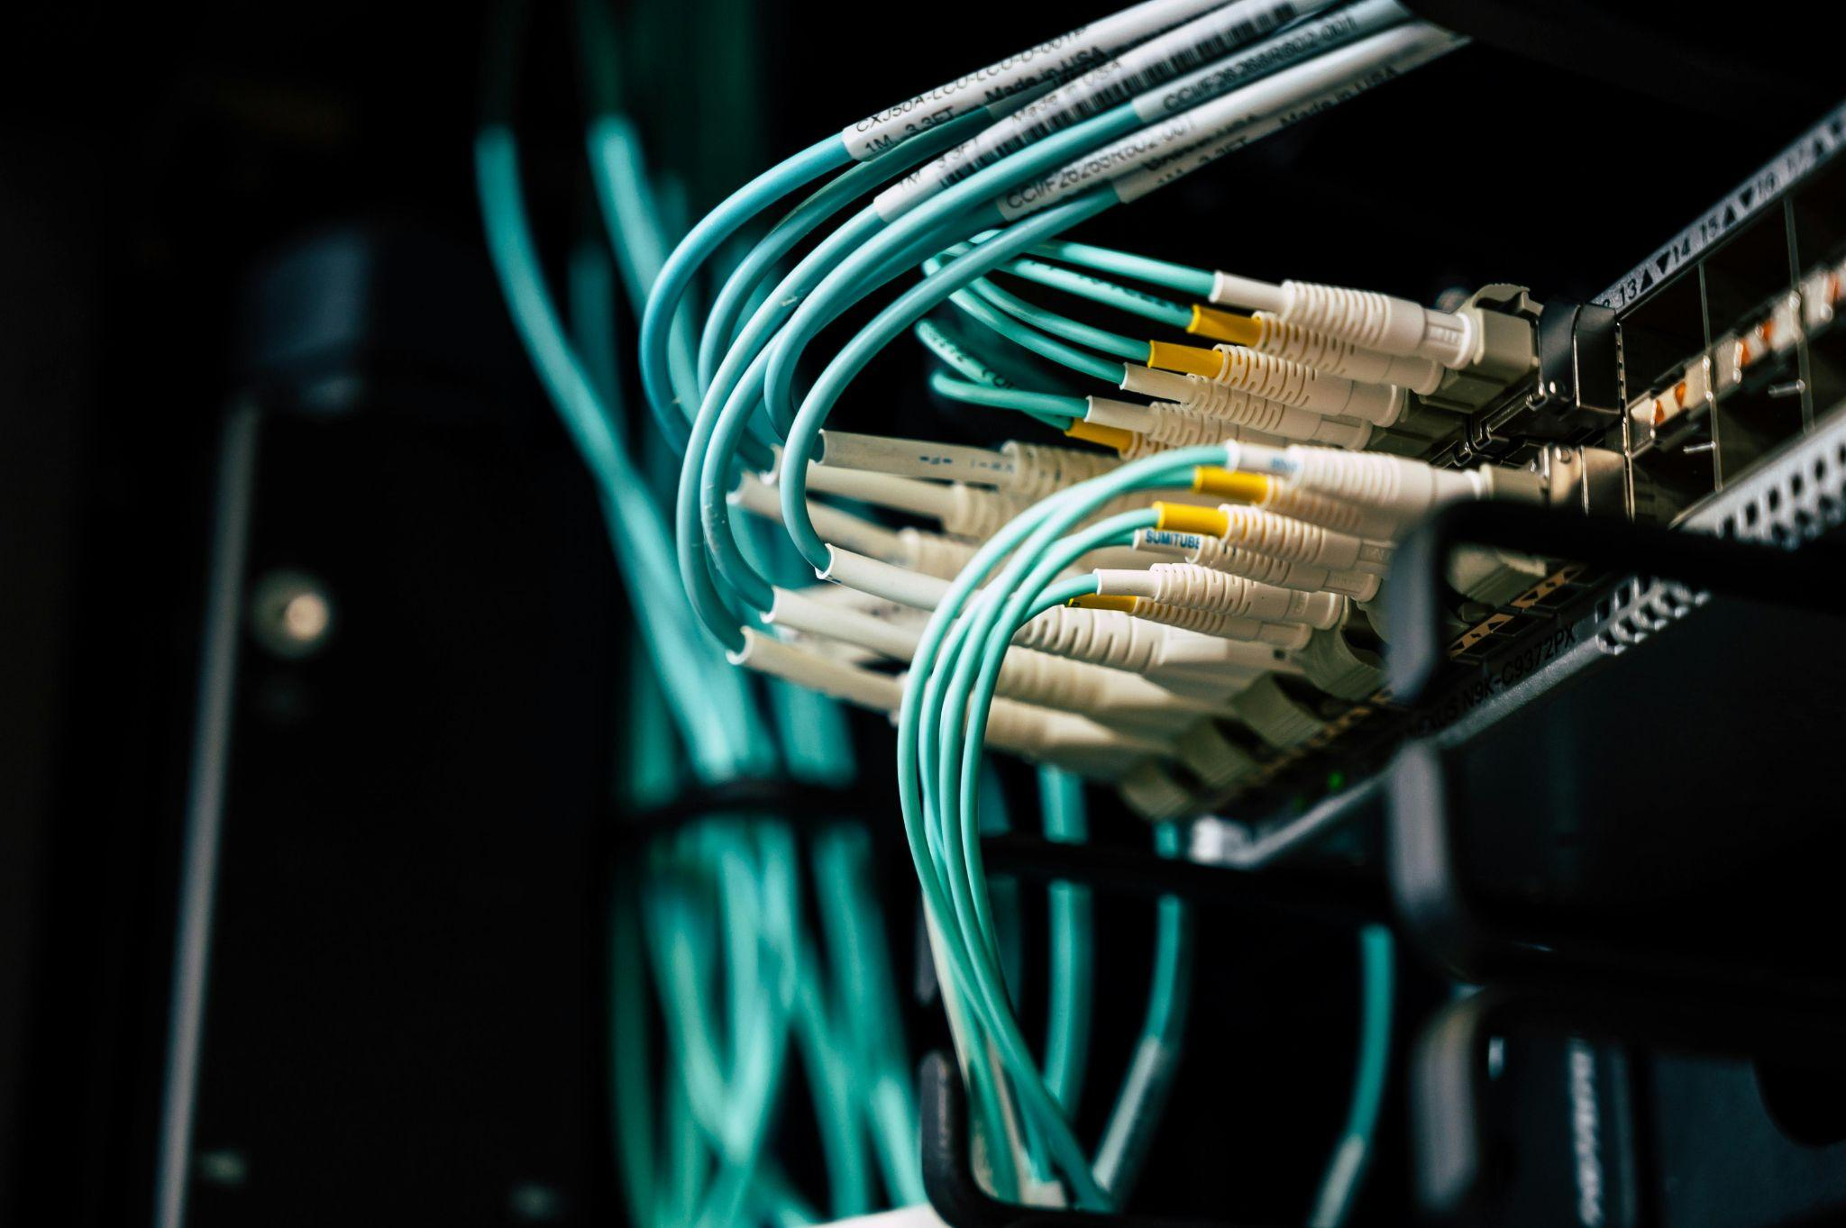
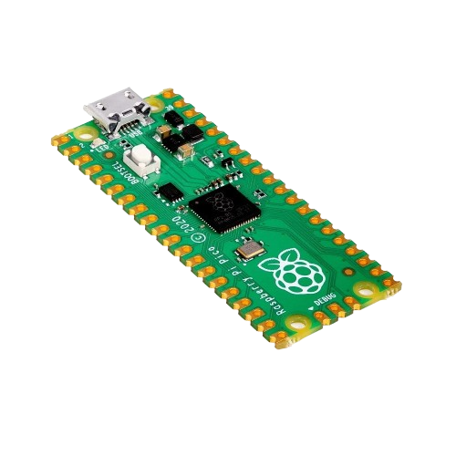
BLOCK DESCRIPTION
Communication of App to the Server
App sends HTTP/S requests to the server, including user inputs or commands.
Utilizes RESTful API endpoints for communication.
Data exchanged in JSON format for lightweight and efficient communication.
Server to Pi Pico W Communication
Server establishes WebSocket connections with Pi Pico W.
Server communication enables remote control of on-board LEDs and GPIO pins of Pi Pico W.
GPIO pins can be manipulated to trigger various actions or interact with external devices connected to the Pi Pico W.

Slide 27
Simulation Results

Slide 28
STM32❌
RPI PICO W ✅
Testing
Write code to initialize the WiFi module and establish a connection to your WiFi network. Use libraries provided by the manufacturer of the WiFi module or the STM32 development environment to simplify this process.
Results of the tests
We were not able to establish a connection due to
compatibility issues in the firmware of either the ESP8266 WiFi module or the STM32 microcontroller.
Conclusions
Due to the above reason we concluded that, it is preferable to use a Raspberry Pi Pico W microcontroller instead of STM32 microcontroller.
Testing
Developed a straightforward Pico SDK program to manage WiFi functionalities on the Raspberry Pi Pico W. This program initializes the WiFi module, scans for available networks, connects to a predefined SSID using appropriate credentials, and incorporates error handling to gracefully manage connection failures.
Results of the tests
We were successfully able to establish a WIfi connection and displayed network scan results and connection status on the console through the developed program.
Conclusions
Due to good connectivity and an in-built Wifi module in RPI Pico W microcontroller, we are going to use this in our Project.
Notes:
//speaker says

Slide 29
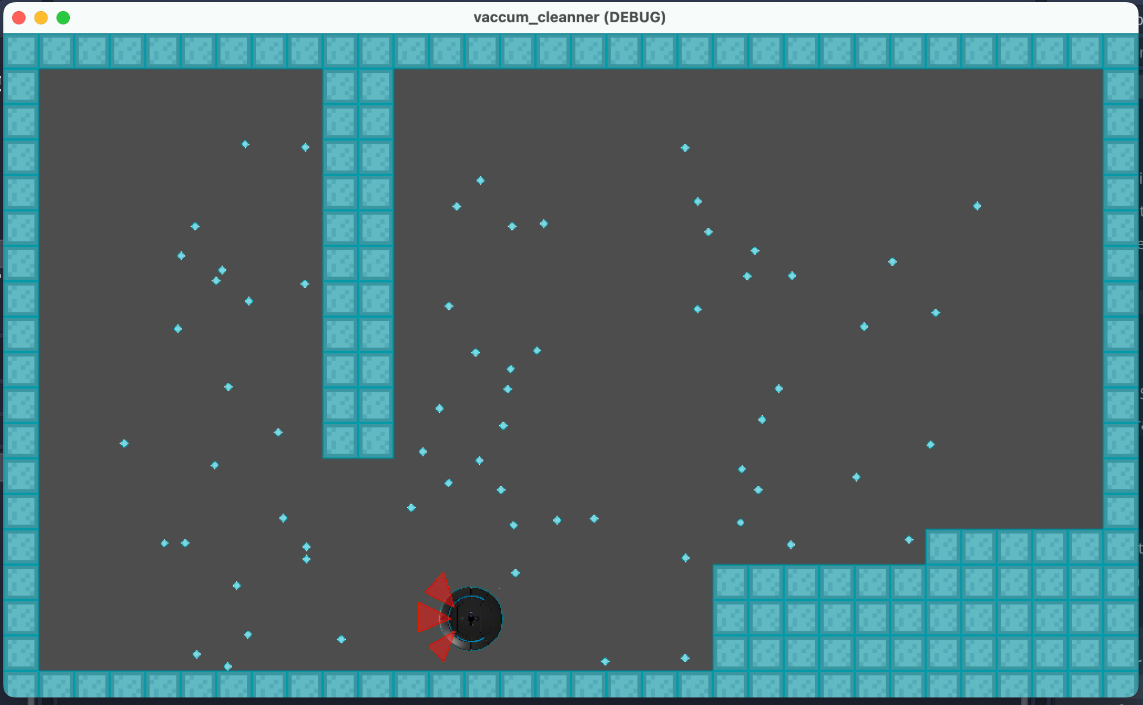
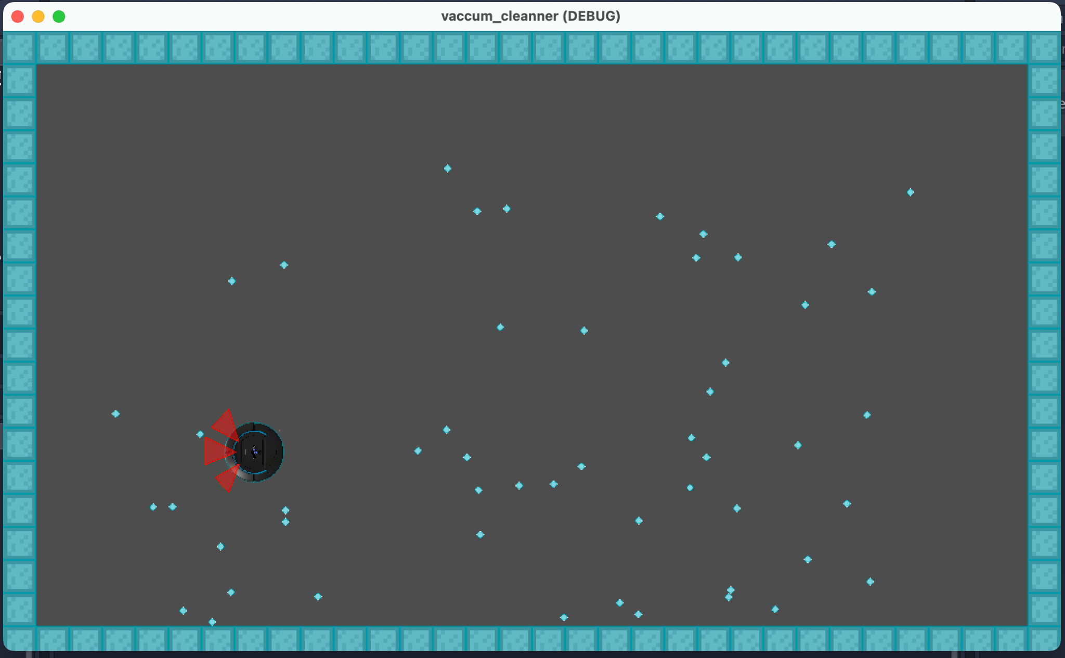
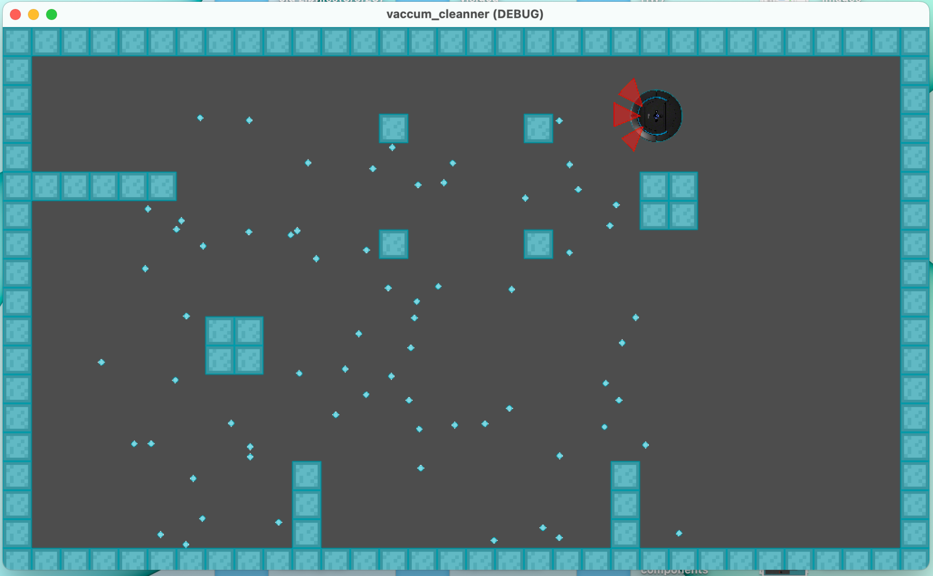
SIMULATION ENVIRONMENT
Empty Uneven Room | Empty Even Room | Room with Obstacles

Slide 30
Algorithms Comparison
Min time for 50%
Overall min time
 | Empty Even Room Sec (% clean) | Empty Uneven Room (% clean) | Room with Obstacles (% clean)
S-Shape | 73 (50%) | 150 (50%) | 80 (50%)
 | 110 (99%) | 270 (80%) | 240 (70%)
Circular | 62 (50%) | 62 (50%) | 78 (50%)
 | 150 (99%) | 160 (95%) | 240 (75%)
Random | 55 (50%) | 50 (50%) | 220 (50%)
 | 240 (85%) | 210 (85%) | 300 (80%)
Random-90 | 76 (50%) | 70 (50%) | 90 (50%)
 | 234 (90%) | 180 (75%) | 270 (70%)
Notes:
//speaker says

Slide 31
Possible Solutions
Automatic Mode Change
Difference: Automatically changes the mode of operation based on predefined intervals or criteria without user interference.
Advantages: Offers convenience as the vacuum cleaner adapts to different cleaning patterns without user interference. Ensures regular variation in cleaning methods, potentially improving cleaning effectiveness.
Disadvantages: Lack of flexibility,Users might prefer specific cleaning patterns for different room layouts or situations. May not always align with user preferences or specific cleaning needs.
User-Selectable Mode
Difference: Allows users to manually select the mode of operation based on their room requirements or preferences through the app.
Advantages: Provides flexibility, allowing users to choose the most suitable cleaning pattern for their specific needs. Enables users to adapt the vacuum cleaner's operation to different room layouts or cleaning preferences.
Disadvantages: Requires user interaction and decision-making, which might not be preferred by all users and they might end up choosing inefficient mode for their need.
Notes:
Choosing the right motor is critical, and our decision-making process involved weighing the benefits of two contenders: the N20 Micro Gear 12V 100RPM DC Motor and the NEMA17 Stepper Motor–D-Type Shaft. The N20 Micro Gear Motor, a cost-effective choice, stands out for its efficiency and high torque - ideal for powering small robots. On the other hand, the NEMA17 Stepper Motor, while potentially less power-efficient at higher speeds, boasts a higher holding torque of 4.2 kg-cm, crucial for maintaining positions. Our decision wasn't just about efficiency; it was about ensuring the right balance for our specific application.

Slide 32
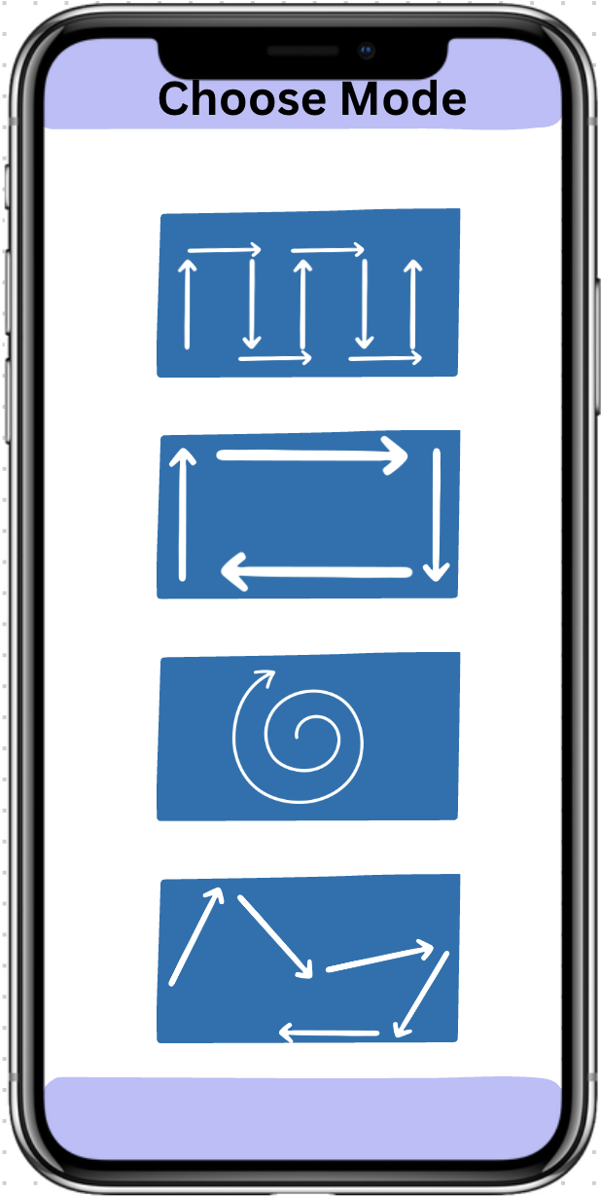
User Selectable Mode

Slide 33
Preparation for
Next Milestone

Slide 34
FlowChart
We are here
Notes:
Now I'll talk about the methodology we'll be using for our project
This flow chart illustrates the workflow of our project
We begin with collaborative brainstorming, which involves exploring available resources and products, as well as conducting research and literature surveys on the designs and functionalities of models available in the market
"Next, we divide our process into subtasks based on mechanical, electrical, algorithm, and app development.
In our mechanical phase, we'll define dimensions and weight based on specifications and design a CAD model for visualization. Electrical tasks involve selecting components, designing circuit schematics, and integrating a WiFi module. Algorithm work focuses on path planning and optimization. As for app development, our initial task is to learn Flutter and become familiar with it to create our app. Then we will make a prototype model from wood and Assembleing the mechanical and electronic components into a final prototype and conductiterative testing and refinement .
After a satisfactory number of tests we proceed to fabrication. Then next final testing and then documentation
// Also explain the chart in little bit detail.

Slide 35
Upcoming Works:
Testing Individual Component
Building prototype
Integrate Wifi with APP on R pico and testing algorithm
Testing current and Voltage levels across all components
Final Testing

Slide 36
Open for Feedback
📝

